Slide 1
ML.NET WORKSHOP
hlubokého učení v produkčním vývoji
BRNO.AI Days in Ysoft
Václav novotný, Martin Horák, Lukáš Válek
Y Soft Corporation

Slide 2
Schedule
What to expect?
Intro presentation
Setup of environment
ModelBuilder + AutoML
Guided demonstration of ML.NET
Individual tasks
Enjoy your trained models!

Slide 3
What is AIVA?

Slide 4
WHERE DO WE USE AI?

Slide 5
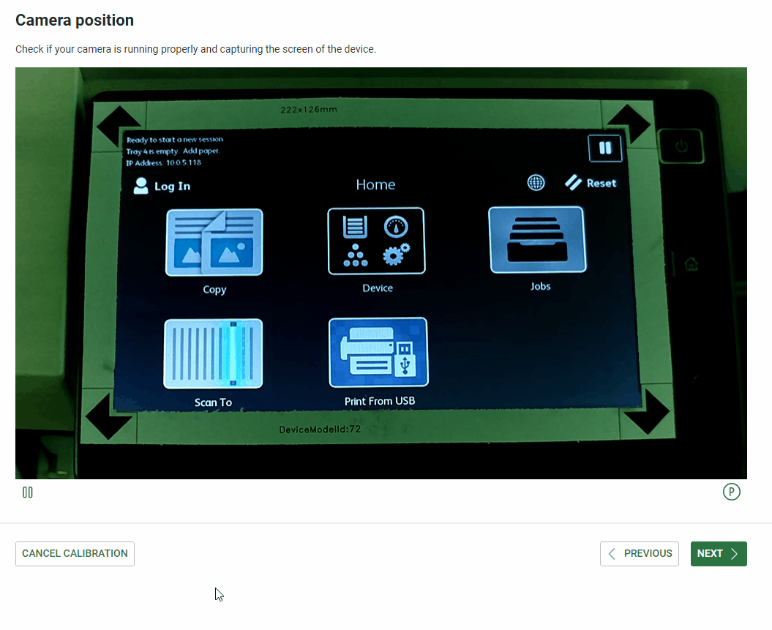
WHERE DO WE USE AI?
Camera calibration

Slide 6
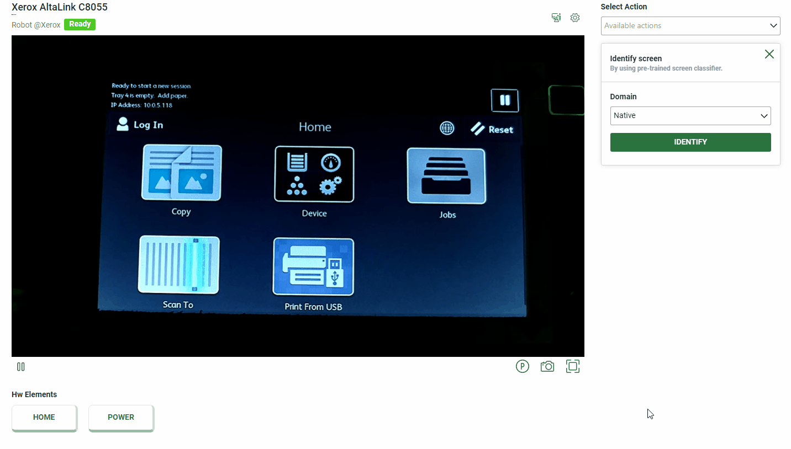
WHERE DO WE USE AI?
Screen Classification

Slide 7
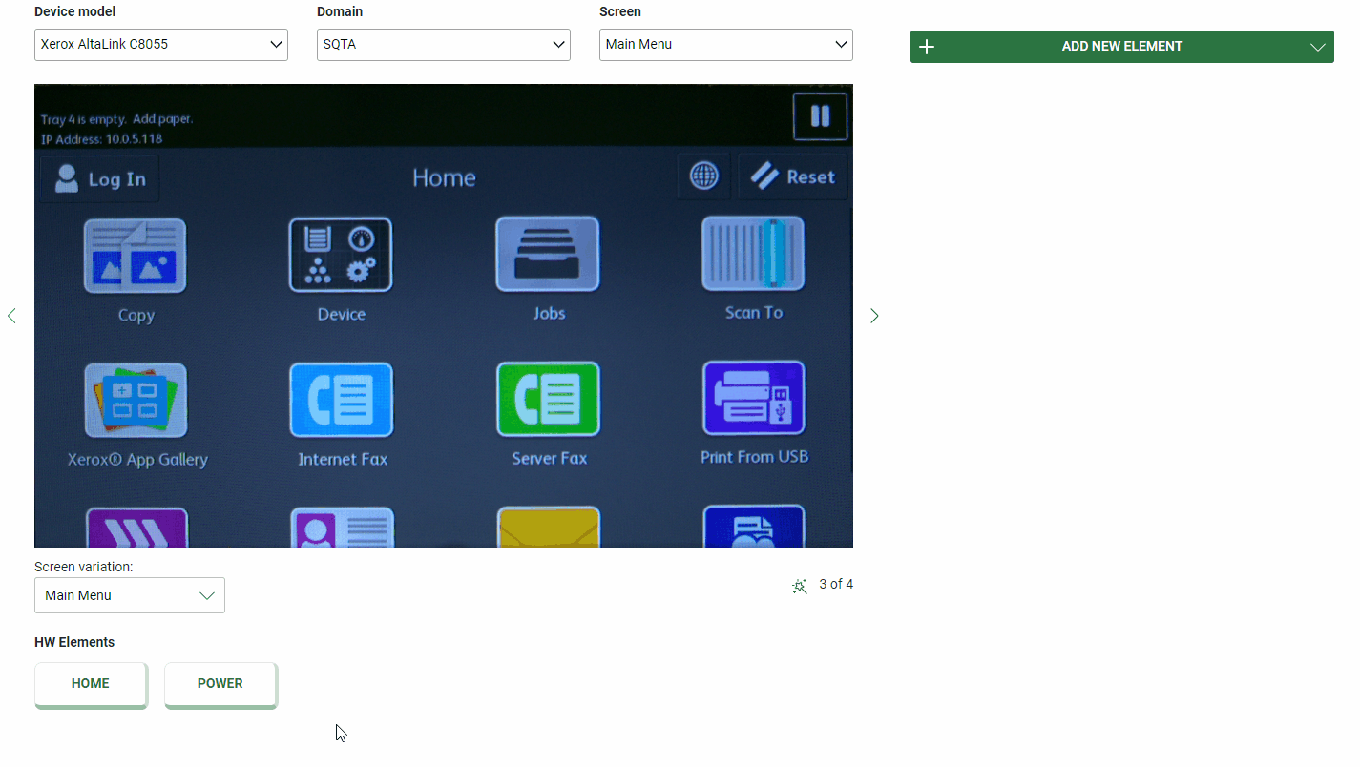
WHERE DO WE USE AI?
Element detection and classification

Slide 8
What tools do we use?

Slide 9

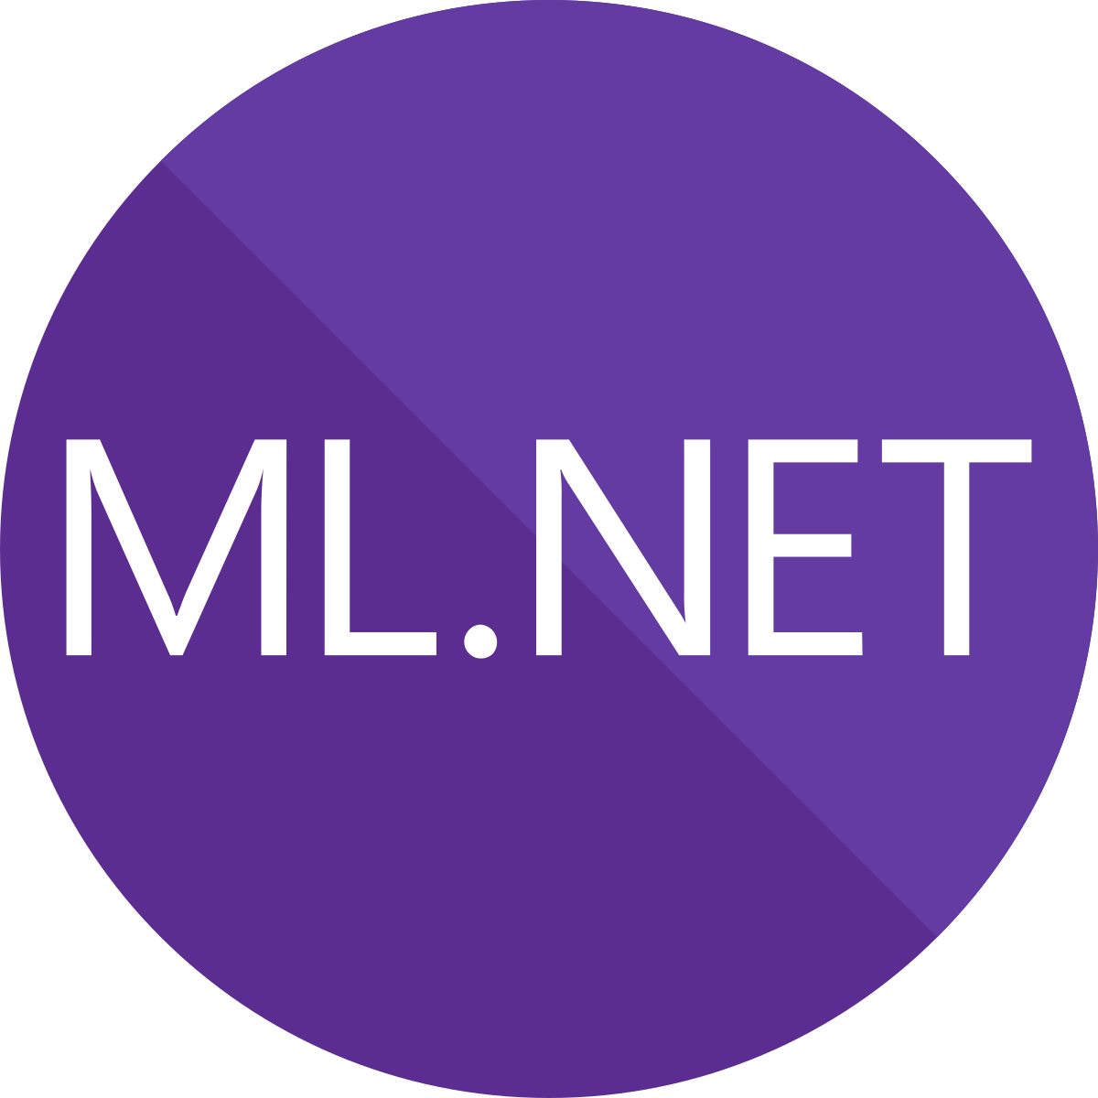
WHAt tool do we use?
OpenCvSharp
Free, open-source, cross platform CV library
OpenCV wrapper for .NET
Opensource computer vision library
ML.NET
Free, opensource, cross platform ML framework
Successor of TLC (The Learning Code)
Works both offline and online
Allows to build, train, evaluate and export ML models
High-level API (Model Builder, AutoML)

Slide 10
Let’s get to work!

Slide 11
Setup
https://github.com/horczech/BrnoAiDaysWorkshop

Slide 12
Contact us
Vaclav.novotny@ysoft.com
Martin.horak2@ysoft.com

